Slide 1
MODULE 3
EIA methodologies: Ad hoc, checklist, matrix, network and overlay- Impact Prediction, Evaluation and Mitigation-Prediction and assessment of the impact on water (surface water and groundwater), air, and noise environment- assessment of ecological impacts and Socio economic Impacts.

Slide 2
EIA methodologies
Simple & widely used EIA methods with criteria to be followed for choosing most appropriate method in a given situation.
Each technique and method for the evaluation of impacts should have the following qualities and characteristics:
1. It should be systematic in approach
2. It should be able to organize a large mass of heterogeneous data
3. It should be able to quantify the impacts
4. It should be capable of summarizing the data
5. It should be able to aggregate the data into sets with the least loss of information because of the aggregations
6. It should have a good predictive capability
7. It should extract the salient features
8. It should finally be able to display the raw data and the derived information in a meaningful fashion.

Slide 3
EIA methodologies
Important methodologies of utility for assessing the impacts of developmental activities on the environment.
1. Adhoc methods 2. Checklists methods
3. Matrices methods
4. Networks methods
5. Overlays methods
6. Environmental index using factor analysis
7. Cost/benefit analysis
8. Predictive or Simulation methods

Slide 4
Ad-HOC method
Only primary and provides impact of the project on larger issues only (Flora, Fauna, Forest, Lake).
No specific parameters are discussed.
Simple method
Useful when time constraints and lack of information
Provides minimal guidance for total impact assessment while suggesting the broad areas of possible impacts and the general nature of these possible impacts.
If more scientific methods available-not recommended.

Slide 5
Types of Ad hoc methods
Opinion poll
Expert opinion
Delphi method
Delphi method :Forecasting process framework based on the results of several rounds of questionnaires sent to a panel of experts.
Several rounds of questionnaires are sent out, and the anonymous responses are aggregated and shared with the group after each round.
Experts allowed to adjust their answers in subsequent rounds.
Since multiple rounds of questions are asked and the panel is told what the group thinks as a whole, the Delphi method seeks to reach the correct response through consensus

Slide 6
Advantages
Specialists on a particular area will provide guidance.
Disadvantage
It require expert.
Short/long term impact are merely examined on guess basis.
Identification, prediction and interpretation of impacts are quite poor

Slide 7
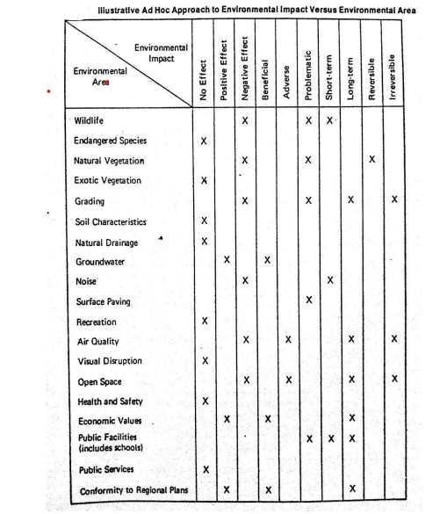

Slide 8
Checklist Methodologies
Checklist means a listing of potential Environmental Impacts.
done to assess the nature of the impacts i.e. its type such as adverse /beneficial, short term or long term, no effect or significant impact, reversible or irreversible etc.

Slide 9
Types of checklists method
Simple lists
Descriptive checklists
Scaling checklists
Scaling Weighing checklist

Slide 10
Simple Lists
Presents a list of parameters related to the project
No guidelines on how to interpret and measure the parameter
Does not help in decision making
No info on cause effect relationship
Strong in impact identification
No information needed on magnitude or importance of impacts"
List of parameters without guidelines provided on how to interpret and measure an environmental parameter.

Slide 11
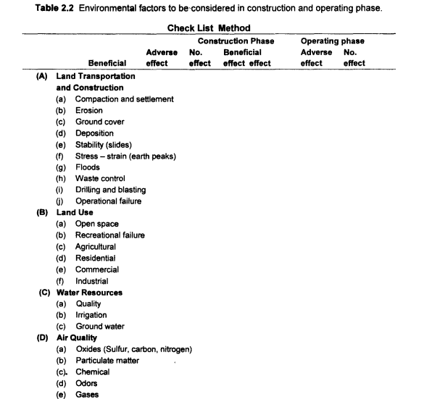

Slide 12
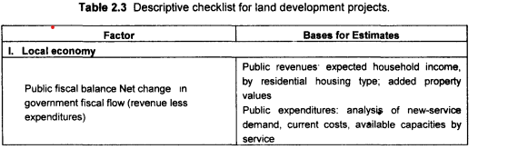
Descriptive checklists
Require information on magnitude or importance of impacts as well as indication on prediction methods and indicators
Includes identification of environmental parameters and guild lines on how to measure data on particular parameter

Slide 13
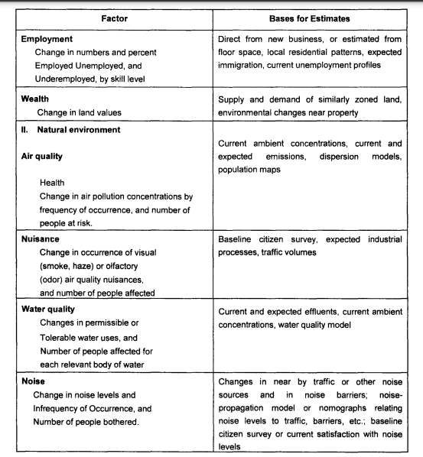

Slide 14
Scaling checklists
similar to a descriptive checklist, but with additional information on subjective scaling of the parameters
List out environmental parameters+ nature of impact
Gives textual rating for impacts
Nature of impact- Direct, Indirect, Cumulative, Long term, short term, severe moderate insignificant, Reversible, Irreversible
Not suitable for impact measurement

Slide 15
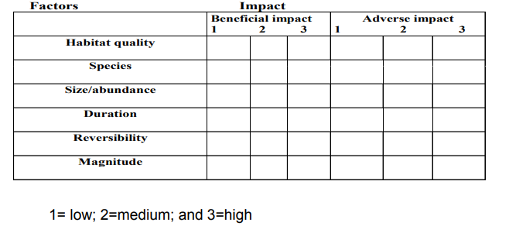

Slide 16
Scaling Weighing checklist
Can be used for decision making- Comparing alternatives
Impact identification, Impact measurement and evaluation Steps involved:
Factors are considered
They are scaled from 0 (worst) to 1 (best)
Weighting (importance) for each factor is given as per expert judgement

Slide 17
Advantages:
1. simple to understand and use
2. Good for site selection and priority settings
Disadvantages
Do not distinguish between direct and indirect impacts
2. Do not link action and impacts
3. Sometime it is a cumbersome task

Slide 18
Matrix method
widely followed method
incorporates a list of activities related to the project with impacted environmental characteristics.
two lists are related in matrix which identifies cause- effect relationship.
The method is able to identify the actions with environmental characteristics.
may indicate the actions which need to be taken into consideration for appropriate mitigation.

Slide 19
Two types of matrices
Simple interaction ‐matrix method developed by Leopold(The matrix lists approx. 100 specified actions and 90 environmental items.)
Stepped Matrix Method

Slide 20
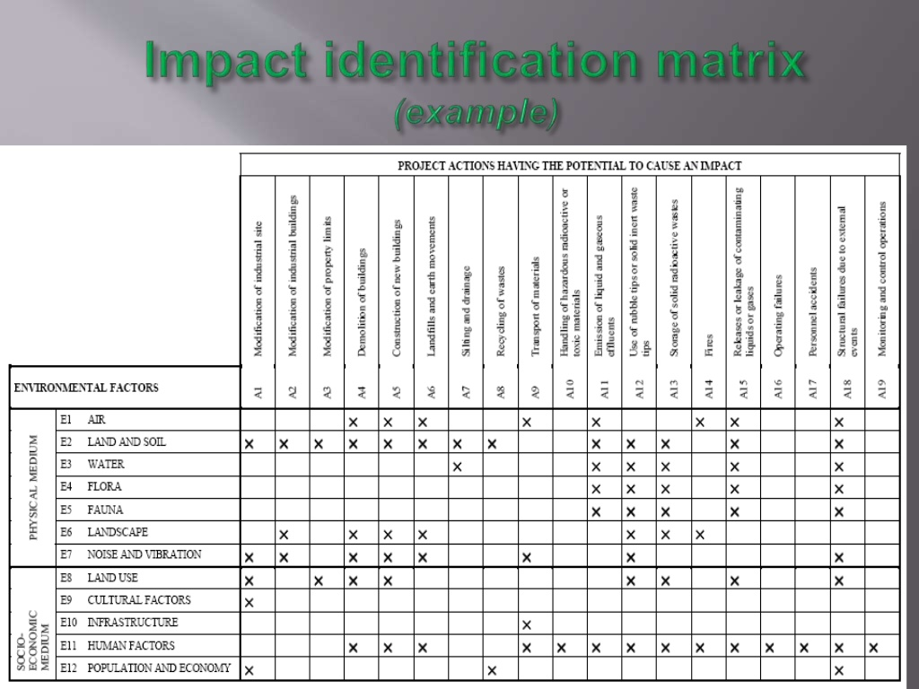

Slide 21
Leopold Matrix
Identify all actions that are part of proposed project
Under the each of the proposed actions, place a slash at the inter-section with each item on the side of the matrix if an impact is possible.
In the upper left hand corner of each box with a slash, place a number from 1 to 10 which indicates the MAGNITUDE of the possible impact.
10 represent the greatest magnitude of impact.
1 is the least magnitude of impact (no zeroes).
Before each number place + (if the impact would be beneficial).
In the lower right hand corner of the box place a number from 1 to 10 which indicates the IMPORT ANCE of the possible impact (Eg. Regional vs. Local).
10 represents the greatest importance and 1 the least (no zeroes).

Slide 22
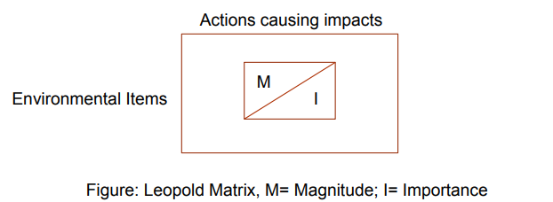

Slide 23
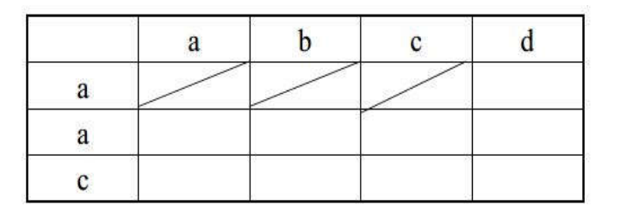
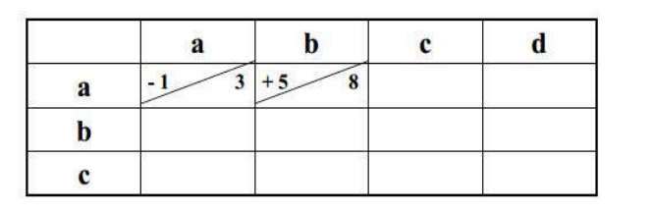

Slide 24
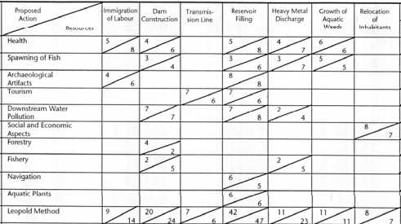

Slide 25
Stepped Matrix Method
Also called cross impact matrix, can be used to address secondary and tertiary impacts of initiating actions
Environmental factors displayed against project actions as well as other environmental factors
Helps in identifying secondary impacts

Slide 26
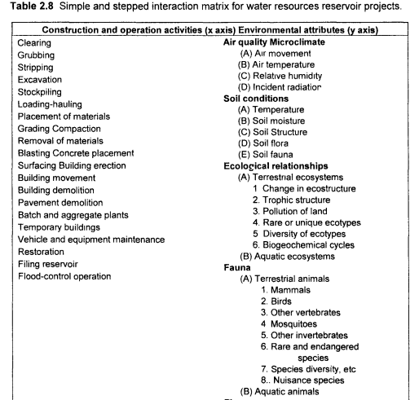

Slide 27
Network method
These methodologies work from a list of projected activities to establish cause-condition-effect relationship.
An attempt to recognize that a series of impacts may be initiated by a project action.
defines a set of possible network & allow the user to identify impacts by selecting appropriate project actions.

Slide 28
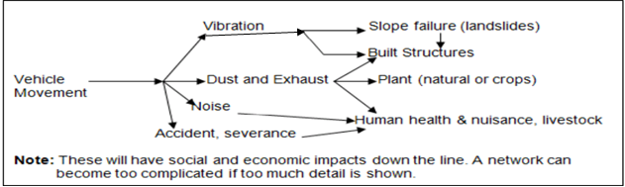

Slide 29
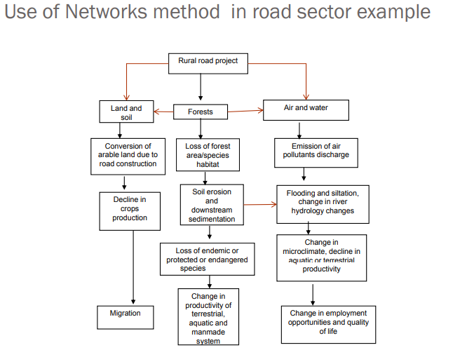

Slide 30
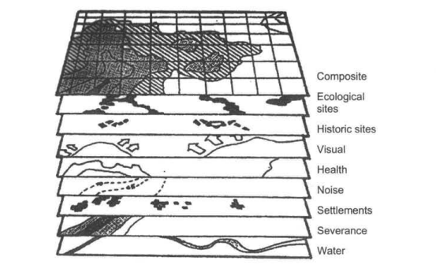
Over lays method
graphical and rely on a set of maps of the characteristics of the project area (physical, social, ecological, aesthetic).
These maps are overlaid by projected alterations of the impacted environment.

Slide 31
Main advantages and disadvantages of impact identification methods
Method | Advantages | Disadvantages
Checklists | easy to understand and use good for site selection and priority setting simple ranking and weighting | do not distinguish between direct and indirect impacts do not link action and impact the process of incorporating values can be controversial
Matrices | link action to impact good method for displaying EIA results | difficult to distinguish direct and indirect impacts have potential for double-counting of impacts
Networks | link action to impact useful in simplified form for checking for second order impacts handles direct and indirect impacts | can become very complex if used beyond simplified version
Overlays | easy to understand focus and display spatial impacts good siting tool | can be cumbersome poorly suited to address impact duration or probability
GIS and computer expert systems | excellent for impact identification and spatial analysis good for ‘experimenting’ | heavy reliance on knowledge and data often complex and expensive

Slide 32
Evaluation and Mitigation-Prediction and assessment of the impact on water (surface water)
Surface water bodies like rivers, streams, canals, ditches, ponds, reservoirs, lagoons, estuaries, coastal waters, lakes etc -play very important role in the sustainability of any ecosystem & it is very important to assess the impacts of any developmental activity on these surface water environments.
Impacts usually caused by physical disturbances ,by changes in climatic conditions, and by the addition or removal of substances, heat, or microorganisms
These activities and processes lead to changes in surface water hydrology, changes in surface water quality, changes in sediment behavior, changes in salinity, and changes in aquatic ecology.

Slide 33
Projects Which Create Impact Concerns for the Surface-Water Environment
1.Industrial power plants withdrawing surface water for cooling (this may be of particular concern during low- flow conditions).
2. Power plants discharging heated waste water from cooling cycles
3. Industries discharging process waste waters from either routine operations or as a result of accidents and spills.
4. Municipal waste water treatment plants discharging primary, secondary or treated waste waters.
5. Dredging projects in rivers, harbors, estuaries and or coastal area (increased turbidity and release of sediment contaminants may occur)

Slide 34
6. Projects involving "fill" or creation of "fast lands" along rivers, lakes. estuaries and coastal area.
7. Surface mining projects with resultant changes in surface water hydrology and nonpoint pollution.
8. Construction of dams for purposes of water supply. flood control or hydropower production.
9. River canalization projects for flow improvements
10. Deforestation and agricultural development resulting in non-point source pollution associated with nutrients and pesticides and irrigation projects, leading to turn flows laden with nutrients and pesticides.
11. Commercial hazardous waste disposal sites and/or sanitary landfills, with resultant run-off water and non-point-source pollution; and
12. Tourism projects adjacent to estuaries or coastal area with concerns related to bacterial pollution.

Slide 35
Systematic Methods for Evaluation of Impacts of Various Developmental Activities on Surface Water
Six step model
Step 1 Identification of Surface Water Quantity or Quality Impacts of Proposed Projects
Step 2 Description of Existing Surface - Water Resource Conditions
Step 3 Procurement of Relevant Surface-water Quantity-Quality Standards
Step 4 Impact Prediction
Step 5 Interpretation of Impact Significance
Step 6 Identification and Incorporation of Mitigation Measures

Slide 36
Step 1 :Identification of Surface Water Quantity or Quality Impacts of Proposed Projects
to determine the features of the proposed project. the need for the project, and the potential alternatives, which have already been or may now be, considered.

Slide 37
Step 2: Description of Existing Surface - Water Resource Conditions
involves describing existing conditions of the surface water resource(s) potentially impacted by the project.
Pertinent activities include assembling information on water quantity and quality, identifying unique pollution problems, key climatological information, conducting baseline monitoring, and summarizing information on point - and non-point - pollution sources and on water users and uses.

Slide 38
Step 3: Procurement of Relevant Surface-water Quantity-Quality Standards
To determine severity of the impact, it is necessary to make use of institutional measures for determining the impact significance. Surface-water quantity and quality standards, regulations, or policies are examples of these measures.

Slide 39
Step 4 :Impact Prediction
"Impact prediction" refers to the quantification (or, at least, the qualitative description), where possible, of the anticipated impacts of the proposed project on various surface water environment factors.
Because of the complex and dynamic nature of hydrological systems accurate prediction of impacts difficult
some uncertainties –usually recorded in the EIS.
Three basic approaches for prediction
Professional Judgement from relevant experience
Extraploation from similar projects in the past
Use of mathematical modelling

Slide 40
considerations relevant to the prediction of surface water quantity/quality impacts
1. frequency distribution of decreased quality and quantity;
2. effects of sedimentation on the stream-bottom ecosystem;
3. fate of nutrients by incorporation into biomass;
4. reconcentration of metals, pesticides, or radionuclides into the food web;
5. chemical precipitation or oxidation-reduction of inorganic chemicals; and
6. anticipated distance downstream of decreased water quality and the implications for water users and related raw-water quality requirements

Slide 41
Step 5 :Interpretation of Impact Significance
For protection and assessment of a significant impact by public opinion collection there are a number of specific numerical standards or criteria.
For example, a number efficient discharge standards are prescribed for discharging into lakes or land with professional judgement.

Slide 42
Step 6: Identification and Incorporation of Mitigation Measures
Mitigation measures - need to be added to the project proposal to make it acceptable.
The mitigation measures might consist of decreasing the magnitude of the surface - water impacts or including the features that will compensate for the surface water impacts.

Slide 43
Prediction and Assessment of Impacts on the Air Environment
Many developmental activities will add air pollutants to the atmosphere or alter the weather and climate result in adverse effects on people, plants, animals, materials buildings etc.
effects can occur at local, regional or even global scale.
evaluation of air quality impacts -a six step methodological approach.

Slide 44
Basic Information on Air Pollution
For systematically evaluating the impacts of potential projects or activities on air quality, the basic information on air pollution sources and the effects of specific air pollutants have to be examined.

Slide 45
Air Pollution Sources
natural sources or from man- made sources.
Sources like windblown dust, volcanic eruptions, Lightning- generated forest fires and biological activity -natural sources
transportation vehicles, industrial processes, power plants, construction activities, and military training activities -man- made sources.
single or point sources (stationary)or area or multiple sources (stationary or mobile)
Pollutant emissions from industrial process stacks, as well as stacks of different fuel combustion processes -point sources,
vehicular traffic, fugitive - dust emissions from resource - material stockpiles or construction, or military training activities over large geographical areas -area sources.

Slide 46
Air Pollution Effect
The air pollution effects can be
effects on human health include eye irritation, headaches, and aggravation of respiratory difficulties.
Plants and crops will be subjected to the undesirable consequences of air pollution, including abnormal growth patterns, leaf discoloration or spotting and death.
Animals such as cattle will be subjected to undesirable consequences of atmospheric fluorides.
(b) Materials damage examples are : property devaluation because of odours, deterioration of materials such as concrete statuary, and discoloration of painted surfaces on cars, buildings, and bridge structures.
(c) Effects on climatic changes include green house effects, ozone depletion, etc.
(d) The aesthetic effects include reductions in visibility. discoloration of air, photochemical smog - related traffic disruptions at airports, and the general nuisance aspects of odors and dust.

Slide 47
Generalized Approach for Assessment of Air Pollution Impact
six- step or six-activity model
I. Evaluation and identification of sources and quantity of air pollutant emissions of different phases of the proposed activity like the construction operation and development:
2. Detailed evaluation of the project area for the existing ambient air quality. emission inventory, and meteorological data;
3. Examination of appropriate laws. regulations, or criteria to be followed for maintaining ambient air quality and I or pollutant emission standards;
4. Carrying out impact assessment studies adopting mass balances, dispersion calculations. comprehensive mathematical models. and! or qualitative predictions based on case studies and professional judgement;
5. Assessment of significance of anticipated beneficial and detrimental impacts; and
6. Development of appropriate mitigation remediation measures for the adverse impacts.

Slide 48
1. Evaluation and identification of sources and quantity of air pollutant emissions of different phases of the proposed activity like the construction operation and development:
has to examine what types of air pollutants are likely to be emitted during the construction and / or operational phases of the proposed project - activity, and their quantities.

Slide 49
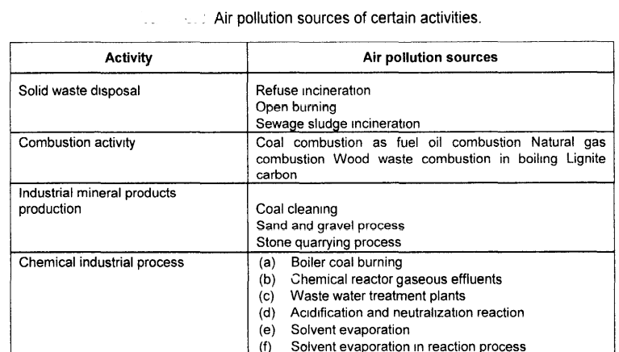

Slide 50
2.Detailed evaluation of the project area for the existing ambient air quality, emission inventory, and meteorological data
Ambient air quality of the study area is to be studied by collecting air samples from different locations of study area
This will help in assessing the present pollution levels of air in that locality .
If pollution levels are higher presently, there are chances for it to deteriorate even more in the future due to the project
Therefore this baseline data will be helpful for the decision makers to take a decision

Slide 51
3.Examination of Appropriate Air Quality Emission Regulation Laws and Air Quality Standards.
The basic information on air quality standards, criteria. and policies of Local ,State and Central Govt agencies which have the statutory authority to maintain the air resources has to be collected.
Documentation of this information allow the determination of the significance of air quality impacts incurred during projects or activities and will aid in deciding between alternative actions or in assessing the need for mitigation measures for a given alternative.
Specific air quality management policies or requirements may be in existence for particular areas and the particular requirements of such policies have to be ascertained.

Slide 52
4.Carrying out Impact Assessment using Mass Balance, Mathematics Modeling and Single Qualitative Approach
Impact prediction can be carried out using various approaches like mass balances, ambient air dispersion models and plume dispersion models.

Slide 53
5.Assessment of Significance of Impacts
Evaluation of the significance of anticipated changes related to the proposed project should be carried out through conducting public meetings and/or public participation programs.
Professional judgement based on the percentage changes from baseline conditions in terms of air-pollutant emissions levels and/or exposed human population should carried out.
These changes should also be considered during both construction and operational phases. For certain type of projects or air-pollutant prediction methods, there are numerical standards or criteria which can be used as a basis of interpretation.
A final impact significance can be assessed based on the specific effects of the types of air pollutants from a proposed project or activity and identification of sensitive receptors in the study area

Slide 54
6.Development of Appropriate Mitigation or Remediation Plans for Reducing Adverse Impacts
measures for reducing the adverse impacts involve project activity design or operational features that can be used to minimize the magnitude of the air quality impacts.
Mainly the design should be revised as needed in order to reduce the air pollutants expected to be emitted from the project-activity. The revised project or activity can then be reassessed to determine whether other remediation or mitigation measures will help in eliminating or minimizing the deleterious air quality impacts.

Slide 55
General mitigation measures minimizing detrimental effects of air pollution
1. Regulatory control on the practice of open burning of agricultural crop residues like delineation of specified times for burning to occur and the establishment of distance requirements between residences and open burning areas will help in reducing air pollutant concentrations in sensitive areas
2. Development of vegetation cover and watering or use of wind breaks, chemical stabilizers -most common method for the temporary dust control of nearly 50%. Planting of rapid growing vegetation in construction areas will reduce dust generation
3. For reducing air pollutant emissions from unpaved roads. paving the surface treating with penetration chemicals, working soil-stabilization chemicals into the roadbed, watering, and traffic-control regulations
4. In the case of open waste piles and staging areas, dry surface impoundments. landfills, land treatment systems, and waste stabilization measures are adopted as fugitive dust control techniques

Slide 56
5. For controlling or reducing air borne pesticide residues resulting from spraying pesticide and other materials. The low-pressure spray nozzles can be used to minimize the generation of fine particles. Further by spraying the pesticide in periods of low wind velocities, dispersion of air borne pesticides can be reduced
6. Several alternative fuels, including methanol. ethanol, compressed natural gas, liquified petroleum gas, electricity-recommended for reducing air pollution from automobiles.
7. A number of advanced exhaust emission control technologies for gasoline and diesel fueled cars, trucks, and buses -to minimize the air pollutant from transportation sector.
8. For purifying gas from various point sources a number of control systems like cyclones, scrubbers, fabric filters, and/or electrostatic precipitators for control of particulate emissions.

Slide 57
Prediction and Assessment of Impacts of Noise on the Environment
Noise is an unwanted sound energy
considered as a pollutant when it exceeds certain limits
Noise as a pollutant produces contamination in environment becoming a nuisance and a cause for annoyance, and affects the health of a person, his activities and mental abilities.
Environmental noise pollution has not been an entirely new phenomenon, but rather a problem that has grown steadily worse with time due to similar factors, responsible for air and water pollution namely increasing population, urbanization, industrialization, technological change

Slide 58
Systematic Methodology for Assessing Environmental Impacts of Noise
a seven-step or six-activity model
1.Identification of levels of noise emissions and impact concerns related to the construction and operation of the development project
2.Description of the environmental setting in terms of existing noise levels and noise sources, along with land-use information and unique receptors in the project area
3. Procurement of relevant laws, regulations or criteria related to noise levels, land-use compatibility, and noise emission standards

Slide 59
4.Conducting impact prediction activities, including the use of simple noise-attenuation models, simple noise-source-specific models, comprehensive mathematical models, and/or qualitative-prediction techniques based on the examination of case studies and the exercise of professional judgement
5.Use of pertinent information from step 3, along with professional judgement and public input, to assess the significance of anticipated beneficial and detrimental impacts
6.Identification, development, and incorporation of appropriate mitigation measures for the adverse impacts
7.Preparation of final environmental impact statement.

Slide 60
Step 1 : Identification of Noise Impacts
The first step is to determine the potential impacts of the proposed project on the noise environment.
Requires the identification of the noise levels associated with the project.
A considerable body of information exists on noise levels associated with a variety of projects and related activities.
The sources, of noise are numerous, so they may be broadly classified into two classes, namely, industrial and non-industrial.
The industrial category :various industries like transportation, vehicular movements, rockets, defense equipment and explosions.
Non-industrial category:loudspeakers, traffic, air crafts, trains. construction works, radios, TVs, vacuum cleaners, and air conditioners in the domestic or commercial use.

Slide 61
Step 2: Description of Existing Noise-Environment
Conditions In analyzing the potential noise impacts of a proposed project , it is necessary to consider the study area (potential project area or region of influence).
The delineation of a study area - made based upon the boundaries of the land associated with the project. or the delineation can include a larger area by considering the area of noise influence within the vicinity of the proposed project.
The primary information to be accumulated -is data on existing noise levels and noise sources within the study area.
Land-use and human-population-distribution maps in relation to the proposed project would also be needed.
If no specific data on existing noise levels is available for the study area. it might be possible to use published noise-level information developed for project involving similar land use.

Slide 62
Step 3 : Procurement of Relevant Noise Standards and/or Guidelines
The primary sources of information on noise standards, criteria, and policies will be the relevant local, state, and federal agencies, which have a mandate for overseeing the noise environment of the study area.
Additional information may be available from international agencies such as the World Health Organization (WHO) or the United Nations' Environment Program.
This information can be used to determine the baseline quality and the significance of noise impacts incurred during projects
it could also aid in deciding between alternative actions or in assessing the need for mitigation measures for a given alternative.

Slide 63
Step 4: Impact Prediction
involves predicting the propagation of noise from a source and determining the type of affected land- use. Several approaches for predicting noise contours
One method of expressing both existing noise and predicted noise levels is by using a level- weighted population value
. A sound-level-weighted population is a single number representation of the significance of a noise environment to the exposed population.
Forecasting noise levels Forecasting methods include equations, computer models. and physical models.

Slide 64
Step 5 : Assessment of Impact Significance
One basis for evaluation of significant impact is public input; this input could be received through a continued scoping process of the conduction of public meetings or public participation programs or both.
The general public can often delineate important environmental resources and values for particular areas. and this should be considered in impact assessment.
Professional judgment can also be useful to assess the percentage changes from baseline conditions in terms of noise levels and/or exposed human population

Slide 65
Step 6 : Mitigation Measures
refer to steps that can be taken to minimize the magnitude of the detrimental noise impacts.
The key approach to mitigation is to reduce or control the noise expected to be emitted from the project
Mitigation can proceed along three possible courses of action, either by changing I. the source of noise, 2. the path of noise from the source to the receiver, or 3. the receiver of noise.
Some additional principles of noise control include the reduction of the number. of vibrating sources, enclosure of the source, and attenuation of noise by absorbing barriers methods.

Slide 66
Step 7: Prediction of Final Impact Statement
The final environment impact statement should include summary tables and discussion with industries.
The results of analysis will help in decision making.
Maps should show location of surface receptors and measurement rates and size balance

Slide 67
Assessment of ecological impacts
Many developmental activities -play a major role in the overall reduction of biodiversity.
proper planning at the project level can go a long way in limiting the loss,
while still serving the needs of the people for which the project is started.
Some development activities have direct impacts on biological systems.
Example- clearing of land for infrastructure will destroy vegetation and displace animals. Introduction of contaminants may cause direct mortality of plants and animals.

Slide 68
in many cases- it is changes in the physical environment caused by development -often lead to secondary or high order changes in plants and animals.
For example, changes in downstream flow as a result of an upstream dam on a river may change the productivity of fish population.
Alternatively, industrial pollution may be transported downstream and move through the food chain and ultimately contaminate the fish and wildlife populations that depend on the river.

Slide 69
General Methodology for the Assessment of Impacts on Biological Environment
Prediction and assessment of impacts on the biological environment involve a number technical and professional considerations related to both the predictive aspects and the interpretation of the significance of anticipated changes,
Biological Impact Assessment
The biological assessment of the impact of any proposed project or action, may include
Results of on-site inspections or surveys
Views of recognized experts
Review of literature and other information
Analysis of effects of the proposed project or action on the species and habitat
Analysis of alternative actions considered

Slide 70
Biological Environment
The biological environment includes plants and animals, the distribution and abundance of the various species and the habitats of communities.
Species forming a community are often inter dependent so that a direct environmental effect on one species is likely to have indirect effect on other species.
This interference acts primarily through food chains but can also act through one species providing a habitat for another species.

Slide 71
(A) Terrestrial Species 1. Terrestrial vegetation: It includes agricultural crops, pasture, the introduction, proliferation or control of noxious weeds as well as the native species.
2. Terrestrial wild life: native mammals, birds, reptiles, amphibians and invertebrates. Migration routes, resting areas, feeding grounds and water sources concentrate wildlife so that such places are particularly sensitive to developmental project activity.
3. Other terrestrial fauna: Included in this group are domestic and farm animals. Human dependence on such animals extends beyond the food chain to include economics and companionship. Insect and snails are especially important as carriers of parasitic diseases, which afflict the human community.

Slide 72
4. Aquatic/marine flora: These are important because they provide an important habitat and food for other aquatic marine life and sustain our fresh water or marine fisheries. Mangrove forests, various species sea weeds and kelp are important. The proliferation of fresh water species can have an impact on the economic use of inland waterways.
5. Fish: They are considered separately because they provide an important source of animal proteins. In addition to fresh water and marine fish, invertebrates such as prawns, shellfish, crales and squid should be considered. Species in the brackish- water estuarine environment are of particular importance to man's food chain.
6. Other aquatic marine fauna: Other species that are not of direct economic importance may form a part of the food chain. Any project, which has a major impact on species populations, can have an equally major indirect impact on the economically important varieties of marine life

Slide 73
(B) Habitats and communities
In considering the environmental effects of development on habitats and communities the special features of terrestrial, aquatic estuarine and marine ecosystems should be considered separately. Special consideration should be given to bird life in considering wetland habitats. 1. Terrestrial habitats : Swamps, wet lands, bird nesting areas, grazing areas, watering places and migration routes should be considered. 2. Terrestrial communities: Special plant communities at high altitudes or those that are residual in an otherwise altered environment should be considered.

Slide 74
3. Aquatic, estuarine or marine habitats : Nursery and breeding areas near shoreline are considered: Wetlands are important. Damage may occur by siltation. Chemical, physical and biological pollutants may each have major impacts. Oil spills are important in marine environment. Gravel beds are important for spawning.
4. Aquatic, estuarine or marine communities : The food chain relationships involving fish and invertebrates and vegetation are important and should be understood. Siltation and chemical pollution can severely disrupt the balance or the very existence of the community. Project design should aim to leave communities intact and at the very least protect key community components such as invertebrates.

Slide 75
Systematic Approach for Evaluating Biological Impacts
a six-step protocol was formulated for planning and conducting impact studies.
This protocol is flexible and can be adapted to various project types by modification as needed to enable the addressing of concerns of specific projects in unique locations.

Slide 76
The various phases associated with the evaluation of biological environment impacts are
1. Identification of the potential biological impacts of the construction and/or operation of the proposed project or activity, including habitat changes or loss of chemical cycling and toxic events, and disruptions to ecological succession
2. Description of the environmental setting in terms of habitat types, selected floral and faunal species, management practices, endangered or threatened species, and special features (such as wetlands)
3. Procurement of relevant laws, regulations or criteria related to biological resources and protection of habitat or species
4. Conducting of impact prediction activities including the use of analogies (case studies), physical modeling and/or mathematical modeling, as based on professional judgment
5. Use of pertinent information from step 3, along with professional judgment and public input, to assess the significance of anticipated beneficial and detrimental impacts
6. Identification, development and incorporation of appropriate mitigation measures for the adverse impacts.

Slide 77
Step 1: Identification of Biological lmpacts
The first step is to qualitatively identify the potential impacts of the proposed project on biological resources, including habitats and species. Many projects can cause terrestrial habitat loss.
The loss and degradation of terrestrial environments could be classified into eight casual categories: I. Land conversion for industrial and residential use, 2. Land conversion for agricultural use, 3. Land conversion for transportation use, 4. Timbering practices, 5. Grazing practices, 6. Mining practices, 7. Water management practices, and 8.Military, recreational. and other activities.
These causal activities contribute to the degradation and loss of ecological values, including animal and plant species: ecosystem structure and ecosystem function (energy flow, nutrient cycling, and water retention

Slide 78
Step 2: Description of Existing Biological - Environment Condition
The preparation of the description of the flora and fauna - and other natural resources and habitats constituting the biological - environment setting.
This description should primarily focus on community types (habitat types) and their geographical distribution.
It may be desirable to identify certain selected species and to include descriptions of those selected species for each community type. There are several options for achieving this step, like 1. use of species lists with qualitative descriptions, 2. use of structured data presentations with qualitative - quantitative descriptions, 3. use habitat - based methods, and 4. use of energy system diagrams.

Slide 79
STEP 3 : Procurement of Relevant Legislation and Regulations
The primary sources of information on pertinent legislation, regulations, criteria, or guidelines related to the biological environment include environmental and/or natural resource agencies of the central and state levels. Local agencies and/or conservation groups may also provide pertinent information. Procurement of this information will facilitate the evaluation of baseline conditions and the data obtained can serve as a basis for impact significance determination .
Most of the biological-environment legislation, regulations, criteria, or guidelines are qualitative in terms of specific requirements. This is in contrast to' the substantive areas of air quality surface water and groundwater quality, soil quality, and environmental noise for which numerical standards are available. Sound professional judgment must be exercised in applying the qualitative requirements for the biological environment in this

Slide 80
STEP 4 : Impact Prediction
The most technically demanding step
As a general principle the impacts should be quantified where possible with qualitative descriptions provided for those impacts which cannot be quantified.
From historical perspective, impact prediction for the biological environment has focused on land-use or habitat changes and the associated implications of those factors relative to the biological system.
Several options are available for impact prediction approaches, including qualitative descriptions of impacts, the use of habitat methods or ecosystem models, and the use of physical models or simulations

Slide 81
Step.5: Assessment of Impact Significance
Is a function of impact magnitude and the value, sensitivity and recoverability (resilence) of ecological receptors.
Interpretation of the anticipated impacts of a proposed project -considered not only in terms of individual species, but also relative to the general characteristics of the affected habitat and overall ecosystem.
One basis -is to apply the institutional information described earlier, including relevant laws, regulations, criteria and guidelines.
Another basis -is the biological science of professional interpretation approach. This involves the application of professional judgement and knowledge of biological-ecological principles, and it demonstrates why it is necessary for a biological scientist to be a part of an interdisciplinary study team.

Slide 82
STEP 6 : Identification and Incorporation of Mitigation Measures
include avoidance, minimization, rectification, preservation, and/or compensation and are associated with project location alignment design or construction and operating procedures.
The location of a project can be a key factor. It is usually determined.
Fresh water ecosystems are almost profoundly influenced by adjacent terrestrial ecosystems, mitigation frequently involves maintaining these areas.

Slide 83
PREDICTION AND ASSESSMENT OF IMPACTS ON THE SOCIO-ECONOMIC ENVIRONMENT
‘Socio-Economic’-being of, relating to, or involving combinations of social and economic factors.
SEIA is the systematic analysis used during EIA to identify and evaluate the potential socio-economic and cultural impacts of a proposed development on the lives and circumstances of people, their families and their communities.

Slide 84
SEIA -also provides a forum for planning how to maximize the beneficial impacts of a proposed development.
Beneficial impacts can include:
a better standard of living due to increased access to employment, business opportunities, training and education
greater access to and from a community and
increased funding to improve social infrastructure and cultural maintenance programs.

Slide 85
Conceptual Frame Work For Socio Economic Assessment
Step 1 : Study Area Delineation and Categorization of Present Activities
Step 2 : Identification of Socio-Economic Impacts
Step 3 : Description of existing socio-economic condition of the study area
Step 4 : Procurement of Relevant Standard/Criteria/Guidelines
Step 5 : Impact Prediction with and without Project
Step 6 Assessment of Significance of Socio-Economic Impacts
Step 7: Incorporation of Mitigation Measures in the Project and Preparation of Draft Environmental Impact Statement

Slide 86
Step 1 : Study Area Delineation and Categorization of Present Activities
The delineation of study area for the analysis of social and community effects requires a sufficient knowledge of the characteristics of the proposed project or activity.
The proposed project alternatives should give sufficient detail to enable understanding of both the construction process and the long-term or operational, characteristics.
Definition of the boundaries of the study area may also be influenced by the availability of population and employment data.
Census tract data is most often used to define population characteristics. The study area boundaries are, therefore, in some cases defined by the boundaries of census tracts or block data.
The basic impact area associated with predicting and assessing impacts on the socioeconomic environment is called the "Regions Of Influence" (RoI). This represents the geographical area, or region, wherein the project- induced changes to the socio-economic environment will occur.

Slide 87
Step 2 : Identification of Socio-Economic Impacts
Potential socio-economic impacts can be identified through the use of interaction matrices, networks, simple checklists, and/or description checklists.
Case studies of similar project types can also be helpful.
Some of the socio-economic factors and their potential changes resulting from project implementation are in table below

Slide 88
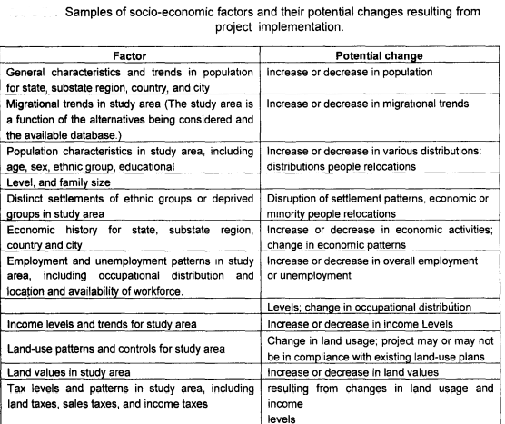

Slide 89
Step 3 : Description of existing socio-economic condition of the study area
Existing socio-economic conditions and physical parameters of the Region Of Influence (ROI) have to be examined on the basis of
(a) Areas separated from the surrounding areas by physical boundary obstruction like rails, roads, high ways, and rivers.
(b) Area of residential land- use surrounded by other uses such as commercial and in d llstri al.
(c) Area with a concentration of special population groups, such as, elderly, lowincome or a specific ethnicity.
(d) Area with like housing types, such as, mobile homes, single family homes, or highdensity condominiums or apartments.
(e) Area of distinct housing value, compared with surrounding areas.
(f) Area of predominantly one type of population employment, such as, professional. (g) Area with an established community group or organization.
(h) Area where the average length of residence in the same housing unit is more than five years, as opposed to areas of more-transient residents.

Slide 90
Step 4 : Procurement of Relevant Standard/Criteria/Guidelines
involves relative comparison of the effects with standard/criteria published by professional stamps/organization with public guidelines or standard for various social activities.

Slide 91
Step 5 : Impact Prediction with and without Project
Modeling of economic demographic impacts provides basic information for addressing public service impacts (education. health services, police and fire protection, utilities, and solid-waste management), social impacts (housing, transportation. urban land use, and land ownership), and fiscal impacts.
Fiscal impacts are themselves dependent upon many public services and social impacts.
The Quality Of Life (QOL) represent, it composite indication of economic, demographic, public service. social, and fiscal impacts along with impacts caused by still other factors related to a sense of well being at a given time and location.

Slide 92
Step 6 Assessment of Significance of Socio-Economic Impacts
Assessment of the significance of predicted changes in the socio-economic environment requires considerable exercise of professional judgment.
Every attempt should be made to use systematic and scientific rationale for significant assessment.
The first consideration relates to the application of screening criteria.
Following this. the interpretation of changes in socioeconomic features can be made based on several approaches: one should consider the resultant impact information relative to recommended professional and institutional standards and criteria for various socio-economic features

Slide 93
Step 7: Incorporation of Mitigation Measures in the Project and Preparation of Draft Environmental Impact Statement
Mitigation of social and neighborhood effects is often very site-specific.
Techniques to avoid impacts may include providing new or revised access to communities;
redesigning of particular features of the proposed project or action to avoid relocations;
constructing noise control walls or security fencing and adding parking areas.

Slide 94
Socio-economic impacts of AIRPORT project
Social impacts:
Increase in traffic flow and congestion around airport
Land use change due to construction
Increased demand for public transportation facilities
Need of housing for new employees
Increased crowd near airport
Increased floating population
Potential removal of business and homes
Displacement of people
Change in character of neighbourhood
Change in accessibility to schools and community services

Slide 95
Economic Impacts:
New jobs created which may be short term (during construction) and long term.
Growth of commercial and industrial activity
Loss of taxable properties by the acquisition of private land
Increased cost for public services like police, fire protection, traffic control, street expansion, etc.
Change in adjacent property values
Increased energy consumption
Increase in tourist oriented revenues and local sale tax revenues.

